Slide 1
Simulated Exercise Media

Slide 2
Why Simulated Media? “The greatest threat to an operation is a dramatic shift in public opinion.” Andrew Exum (2012)
leaders, key staff and the public affairs/relations staff are under constant and intense scrutiny during a crisis
now have unpredicatable news cycles within 24 hour news coverage (official and unofficial)
technology has changed the media environment - critical component of contemporary crisis response
Prosumers (consumer/producers), influencers and state/buiness actors can control the narrative
Result
leadership/key staff must engage and consider the impact of media during crisis and decision making

Slide 3
Methodology Simulation not parody
realism in the means, method, design and delivery of information environment products – web based aggregate news website, social media
realistic and relevant engagements from online and social media platforms
training objective based information environment design
progressive delivery and engagement
safe learning environment

Slide 4
Brunswicker Charlie 20 Information Environment
will reflect agency dialogue and messaging, public commentary, traditional media coverage/response
Chatter (exercise Twitter) - Live messaging and engagement
VNN (aggregate news website) – Online news and Video Clips
includes pre-scripted and dynamic content which reflect TA responses through Exercise media interviews by phone and in person on camera
early access to sites to facilitate ease of use

Slide 5
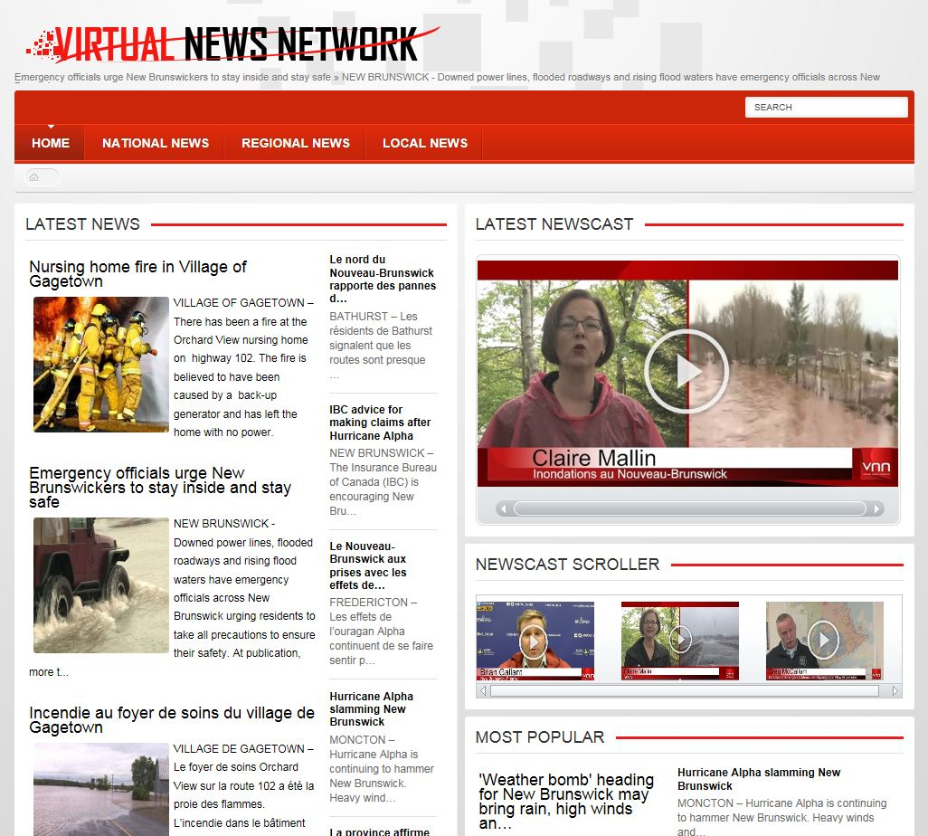

Slide 10
?

